Slide 1
Governmental reforms: Necessary or forced?
Name : Priyanshu Singh
Uid : 18BET1057

Slide 2

What is Reform?
Breaking old rules & regulation to make new one.

Slide 3
Types of Reform
Education Reform(recently in India)
Government reform
Land reform
Economic reform
Social Reform

Slide 4
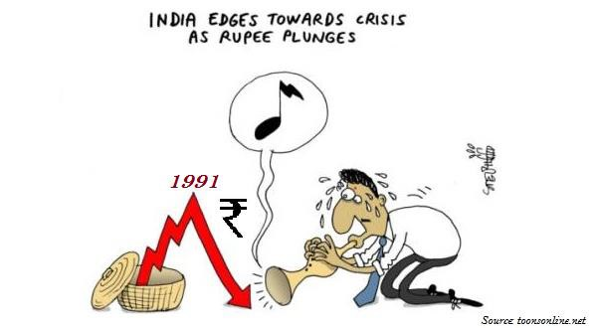
Positive reform
Reform of 1991(India)

Slide 5

Negative Reform
Bolvia water crisis or Bolvia water war

Slide 6
Conclusion

Slide 7
Thank You

